Slide 1

Project implementation & Results
Team 4: COVID-19 Health Informatics
Cheng Ding, David Lin, Jayden Myers, Zewei Lei

Slide 2




Contributions
Cheng Ding
LSTM model
Data preprocessing
David Lin
LSTM model
Pattern Classifier
Zewei Lei
Data preprocessing
Mock-up GUI
Presentation
Jayden Myers
LSTM model
Pattern Classifier

Slide 3
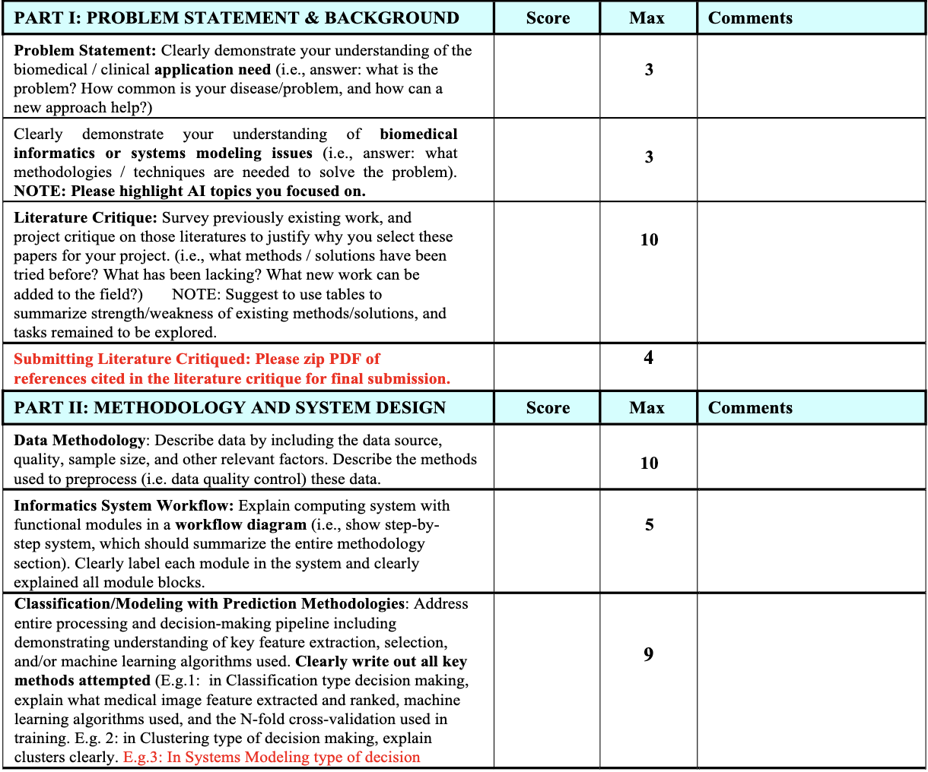
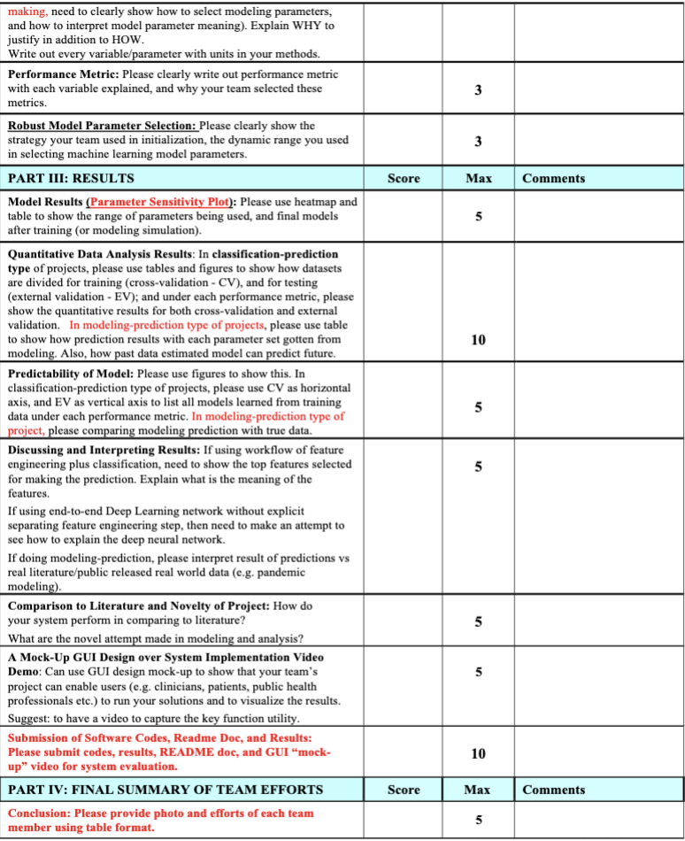

Slide 4



Problem Statement - Part I
Utilizing heart rate, steps, and sleep data to discover patterns suggestive of COVID-19 and develop an interpretable model for COVID-19 detection on a smartwatch

Slide 5
Current Challenges - Part I
Downsides of current diagnostic methods:
PCR test:
Accurate, but results may take hours to days
2. Rapid antigen test:
Limited accuracy, may produce false negatives
3. Antibody Tests:
Not useful for early detection or active infection
The need for a new solution:
Harnessing physiological data for accessible, trustable diagnosis
Addressing limitations of existing testing methods (i.e., limited accuracy, high time consumption…)
Developing a cost-effective and widely available model

Slide 6
Literature Critique (1) - Part I
Survey of COVID-19 Management + Detection [3, 4, 7]:
The use of BioMets - System utilizing sensor data (Fitbit) to detect viral disease
Current implementations include non-DL models
KNN, Decision Trees, Random Forest
Future focus on Neural Networks
The needs (interpretable model):
Explains previous model choices
Trust + Reliability are key factors to model success
The largest pitfall is poor data quality
Notes:
To strengthen our understanding of the topic, we many previous studies to prepare our projects. We classified these studies into three different categories.

Slide 7
Literature Critique (2) - Part I
BioMet/Algorithm Implementations[1, 5, 6, 9, 10, 11]:
Utilize features including RHR, Respiration, RMSSD (HR Var), and Symptom data
Day of Detection, utilizing a CNN: 0.77 AUC
12% of the dataset was asymptomatic
These features show visible shifts around day of diagnosis
Utilizing smartphone capabilities - Temperature, Breathing
Inclusion of IMU data
Random Forest, 79% Accuracy at H1N1 detection
Similar data used in Influenza Like Illness (ILI) detection
Increased RHR and abnormal Sleep found to be the most contributing factors
Notes:
root mean square of successive differences between normal heartbeats (RMSSD)

Slide 8
Literature Critique (3) - Part I
Literature Review - Long Short Term Memory (LSTM) [8, 12, 13, 14]:
Has been used to predict case and death numbers from real time data (r > 0.98)
Pattern Matching to determine risk states
Anomaly Detection
Trained on baseline (control) cases, RHR data
Able to detect >50% prior to diagnosis time, Acc = .91
Later improved to 80% by utilizing a variational auto-encoder
Individualized Model
Linear and Sequential model layouts found to perform best
Global Model
Contrastive Convolutional Auto-encoder
Converts 2 Weeks of time series data into an image
Able to achieve roughly 0.9 AUC with 100% Sensitivity on RHR data

Slide 9
Method Summary - Part II
Long Short Term Memory (LSTM):
Higher interpretability, previously used for COVID detection
High computational complexity, overfit
Very strong performance in anomaly detection
Contrastive Auto-Encoder (CAE):
Best classification performance
Limited replication, less representative
Data used may not be representative of our data
Random Forest:
Global model rather than individualized
Lowest performance
Convolutional Neural Network:
Better performance
Tuned hyperparameters/layers, worse performance
Notes:
To sum up the methods in previous studies, we identified a list of features for each.

Slide 10

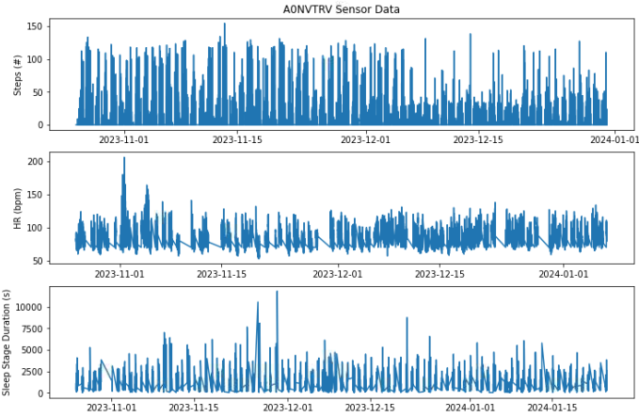
Data Methodology - Part II - Data source: Mishra et al., 2020
Patient Level Information
 | Number of Patients | Average Timeseries Duration [days]
Covid patients | 32 | 82
Healthy patients | 74 | 81
Sensor Data Information
 | Sampling Rate [s] | Available Data [%]
Steps Data | 60 | 100
HR Data | 5 | 100
Sleep Data | N/A | 27
Example Timeseries for 1 Subject
Notes:
Our study involves several steps to evaluate the efficacy of our proposed method for processing time series data from wearable devices to detect Covid-19.Firstly, we preprocess the raw time series data collected from each patient. This involves cleaning and transforming the data to remove any errors or inconsistencies that may impact the model's performance. Next, we split the preprocessed data into training and testing sets at the patient-level. This is done to prevent any potential data leakage problems that may arise from sharing data across different patients.
After splitting the data, we train the LSTM model on the training set. The model is designed to learn and recognize patterns within the time series data that can be used to make accurate predictions about clinical outcomes. To evaluate the performance of the LSTM model, we use several classic metrics such as AUC, accuracy, and RMSE. These metrics provide quantitative measures of the model's ability to accurately classify and predict clinical outcomes based on the time series data. Furthermore, we compare the performance of the LSTM model to prior models that have been used for similar tasks. This comparison serves as a baseline for evaluating the relative merits of our method.
Overall, the objective of our study is to provide a comprehensive evaluation of the efficacy of the proposed method for processing time series data from wearable devices. By leveraging these metrics and baselines, we aim to establish the superiority of our approach and provide a valuable contribution to the field of clinical data analysis.

Slide 11
Informatics System Workflow - Part II
Pattern Mining Stage
Smartwatch Data
Symptom Date
COVID Classification Stage
Data Preprocessing (Pattern Creation)
Frequent COVID Patterns
Data Preprocessing (Pattern Informed)
Split Data
Split Data
Ext. Val. Data
Train Data
Pattern Learning Model
Ext. Val. Data
Train Data
LSTM
Test Model
Test Model
Trained Model
Trained Model
Evaluations (Sens., Spec.)
Evaluations (Sens., Spec.)

Slide 12
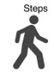

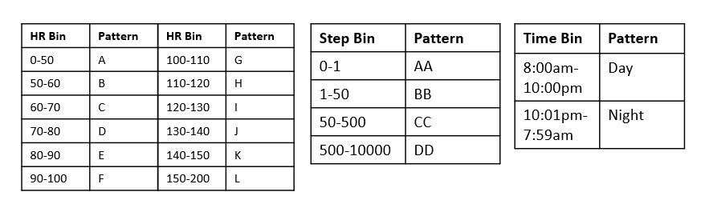
Data Preprocessing (Pattern Creation) - Part II
COVID Symptom Onset
Recovery
Steps
Complete Patient Sensor Data
HR
1-hour
Pattern Creation
Ex: ‘F-AA-Day’
Heart Rate Pattern – Steps Pattern – Time Pattern
Complete Patient Pattern Data
COVID- Pattern Sequence
COVID+ Pattern Sequence
Segmented Patient Pattern Data
24 hours

Slide 13
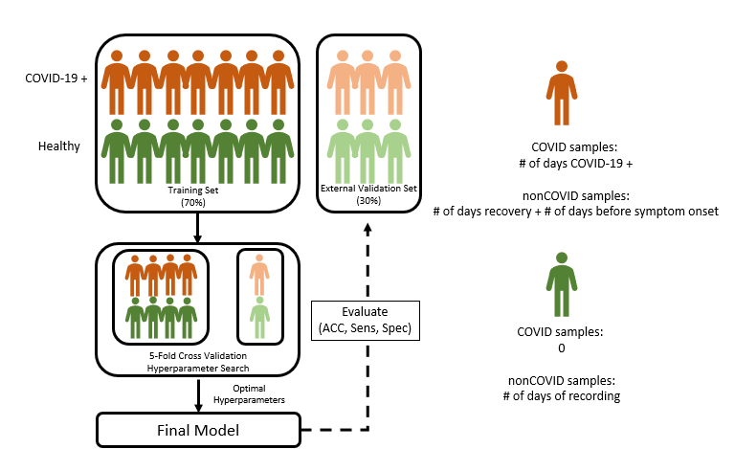
Split Data - Part II

Slide 14
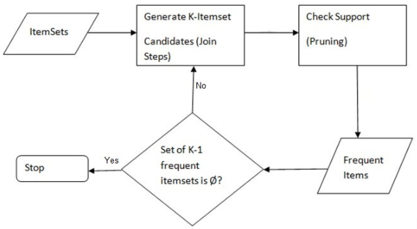
Classification/Modelling (Apriori)- Part II
Frequent Itemset Mining (Apriori)
Returns the frequent individual items found within a database, in this case pattern sequences
Hyperparameters:
Min_support: % of patterns that have to exist in the group (range: 30%-50%)
Pattern Length: how much to chunk the preprocessing step (range: 8hours – 2 days)
Frequent COVID only specific patterns were found by taking the difference in frequent covid patterns and frequent healthy patterns
Naïve bayes was used to classify patterns by how often they occur in the frequent covid only specific pattern set
All Patterns
COVID Patterns
Healthy Patterns
Apriori Alg
Apriori Alg
FreqPats_{covid}
FreqPat_{healthy}
Diff(FreqPats_{covid}, FreqPats_{healthy})
Naïve Bayes
Apriori Algorithm
Classified Patterns

Slide 15
Robust Model Parameter (Pattern Learning)
Pattern length did not change any of the files
As minimum support increases: the length and number of pattern sequences decreases
Frequent COVID Only Patterns
At max support (50): [['C-AA-day']] is the only pattern
At min support (30): [['D-AA-day', 'F-BB-day'], ['D-BB-day', 'E-BB-day'], ['D-AA-day', 'E-AA-day'], ['E-AA-day', 'C-AA-night'], ['D-AA-day', 'D-AA-night', 'C-AA-night'], ['D-BB-day', 'D-AA-night'], ['D-AA-night', 'F-BB-day'], ['C-AA-night', 'F-BB-day'], ['E-BB-day', 'D-AA-day'], ['D-BB-day', 'C-AA-night'], ['D-AA-day', 'D-AA-night', 'E-AA-day'], ['E-BB-day', 'C-AA-night'], ['E-BB-night'], ['D-BB-day', 'D-AA-day'], ['D-AA-day', 'C-AA-day'], ['D-AA-night', 'C-AA-night'], ['D-AA-day', 'C-AA-night', 'C-AA-day'], ['E-BB-day', 'D-AA-night', 'C-AA-night'], ['D-BB-day', 'D-AA-day', 'D-AA-night'], ['E-BB-day', 'C-AA-night', 'D-AA-day'], ['E-BB-day', 'E-AA-day'], ['E-BB-day', 'D-AA-night', 'D-AA-day'], ['D-BB-day', 'D-AA-night', 'C-AA-night'], ['E-BB-day', 'F-BB-day'], ['D-BB-day', 'E-BB-day', 'C-AA-night'], ['D-BB-day', 'C-AA-night', 'C-AA-day'], ['D-BB-day', 'D-AA-day', 'C-AA-night']] is the list of different patterns found more frequently in covid patients
Most frequent patterns have a larger first letter, and lower second:
This indicates high heart rate and low steps → High Resting Heart Rate
‘Heart Rate Pattern – Steps Pattern – Time Pattern’
Pattern Key

Slide 16
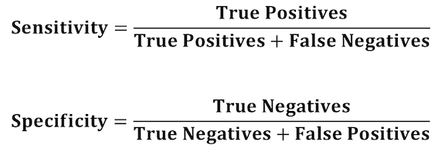
Performance Metrics - Part II
True Positive: Correctly classifying a COVID+ section
Notes:
Chosen because of

Slide 17
Model Results - Part III
Minimum Support | Sensitivity | Specificity | Average [Sens, Spec]
30 | 0.653,0.365, 0.620, 0.776, 0.276 | 0.458,0.388,0.387, 0.389,0.421 | [0.6, 0.467]
35 | 0.184, 0.428, 0.25,.443,0.411 | 0.702,0.650,0.645, 0.651,0.648 | [0.366,0.704]
40 | 0.316,0.602,0.653, 0.569,0.606 | 0.466,0.473,0.514, 0.424, 0.635 | [0.556,0.511]
45 | 0.21,0.388, 0.538,0.582,0.164 | 0.767,0.65,0.684, 0.721,0.777 | [0.328,0.724]
50 | 0.29,0.245,0.578, 0.279,0.141 | 0.893,0.757,0.744, 0.821,0.77 | [0.257,0.777]
Notes:
Having more of the elements that differentiate covid, being the fuller support difference vector will lead to better classification of covid patients, while increasing the support will decrease the pattern list and lead to better non-covid performance and accuracy (due to data imbalance)

Slide 18
Data preprocessing
Resting Heart Rate
define RHR as the HR measurements recorded when there were zero steps taken during a rolling time window of the preceding 12 minutes (including the current minute).
Negative
Positive
Positive
Positive
Negative
RHR
8H
8H
8H
8H
8H
Covid
Symptoms onset
Recovery
Negative
Negative
Negative
Negative
RHR
8H
8H
8H
8H
Healthy

Slide 19
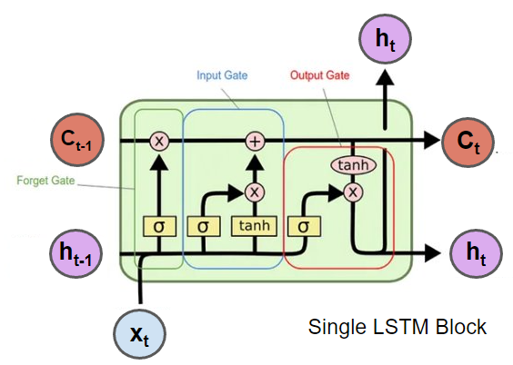
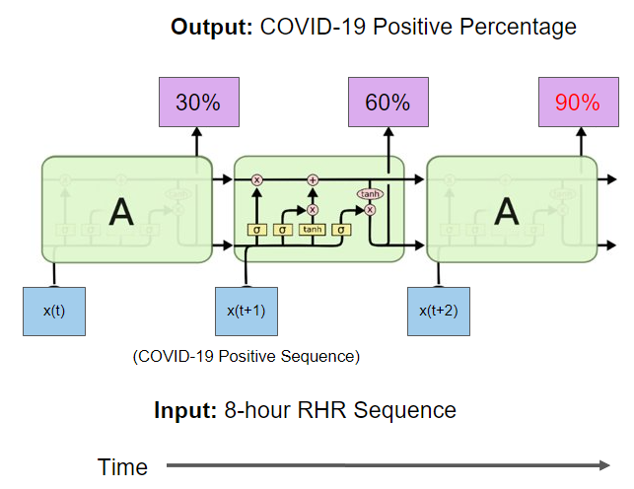
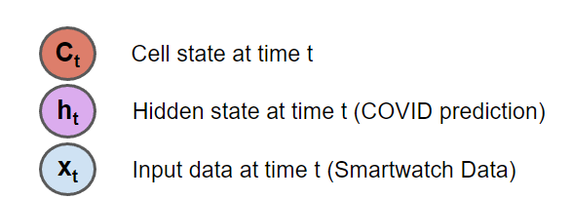
Long Short-Term Memory networks (LSTM) - Part II
LSTMs learn temporal dependencies in timeseries data very well over long and short periods of time
Used in prior works for COVID-19 anomaly detection with strong results (Bogu et. al, Abir et. al)
LSTM is made up of cells that selectively retain and reject information that represents the whole sequence being fed in.
Hyperparameters:
LSTM hidden state units: 16-128
Number of layers: 3-8
Batch Size: 16-128
Learning rate: 1e-4 - 0.05

Slide 20
Data preprocessing
Scaling
Rotation
Permutation
Magnitude_warp
Time_warp
window_slice
window_warp
 | #patients | #strips
Covid patients | 32 | 5716/45728(after DA)
Healthy patients | 74 | 54571
Data augmentation

Slide 21
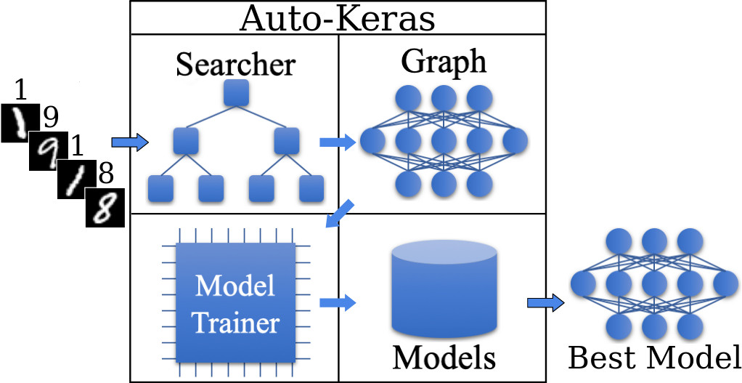
AutoML does not work
Autokeras is difficult to deal with imbalance dataset. We have to tune the parameters manually.

Slide 22
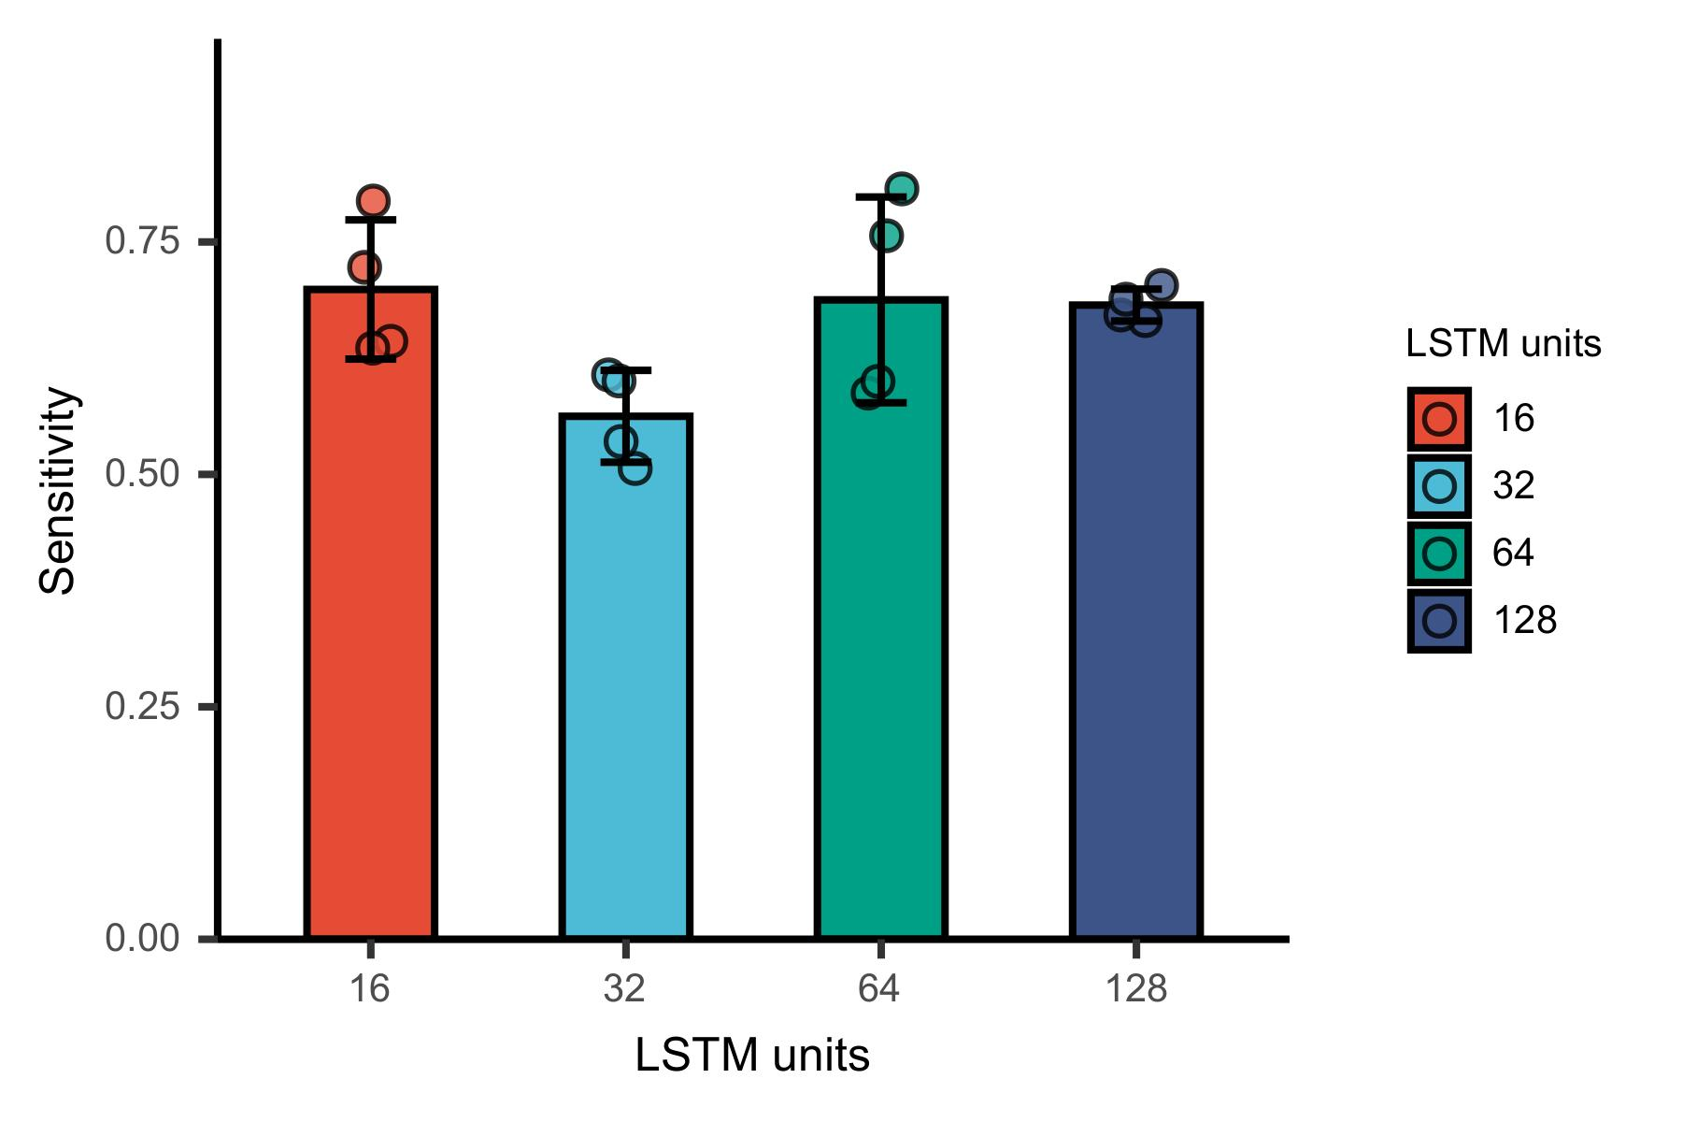
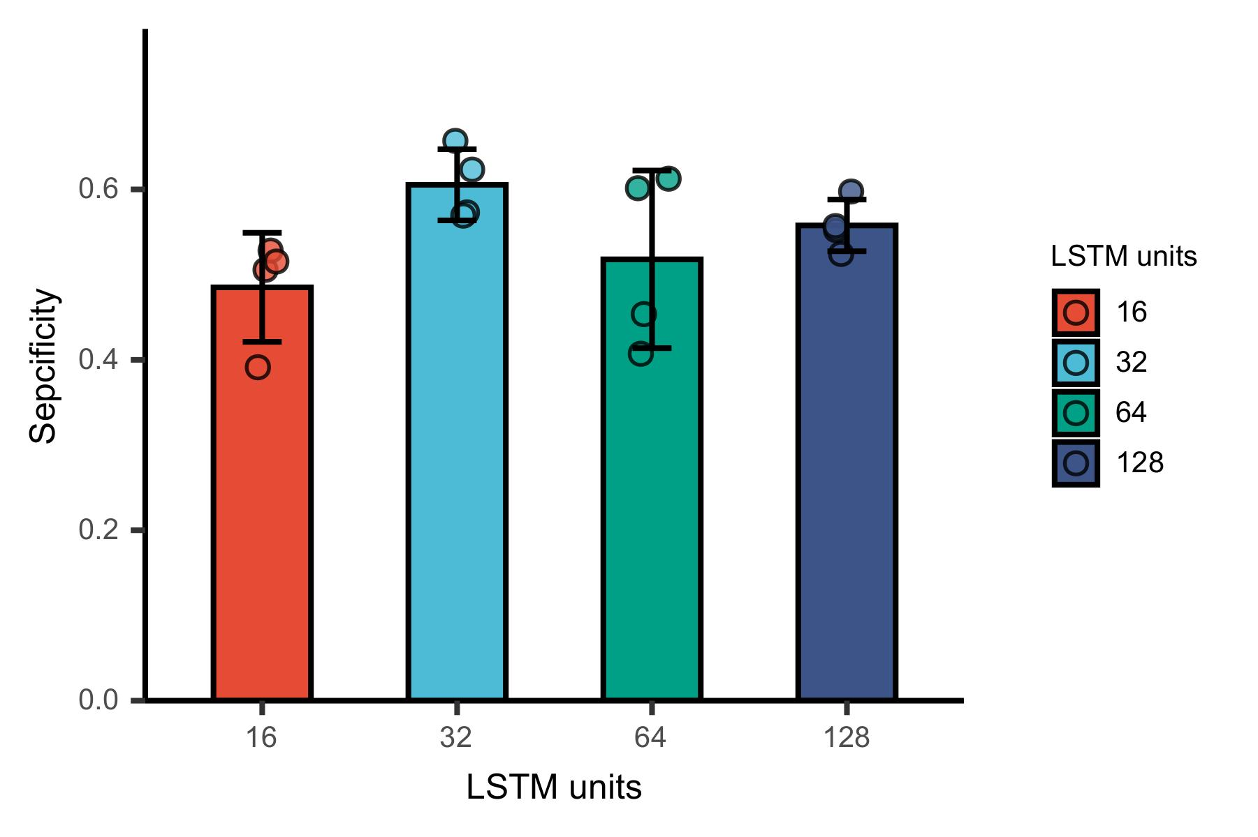
Robust Model Parameter Selection - Part II

Slide 23
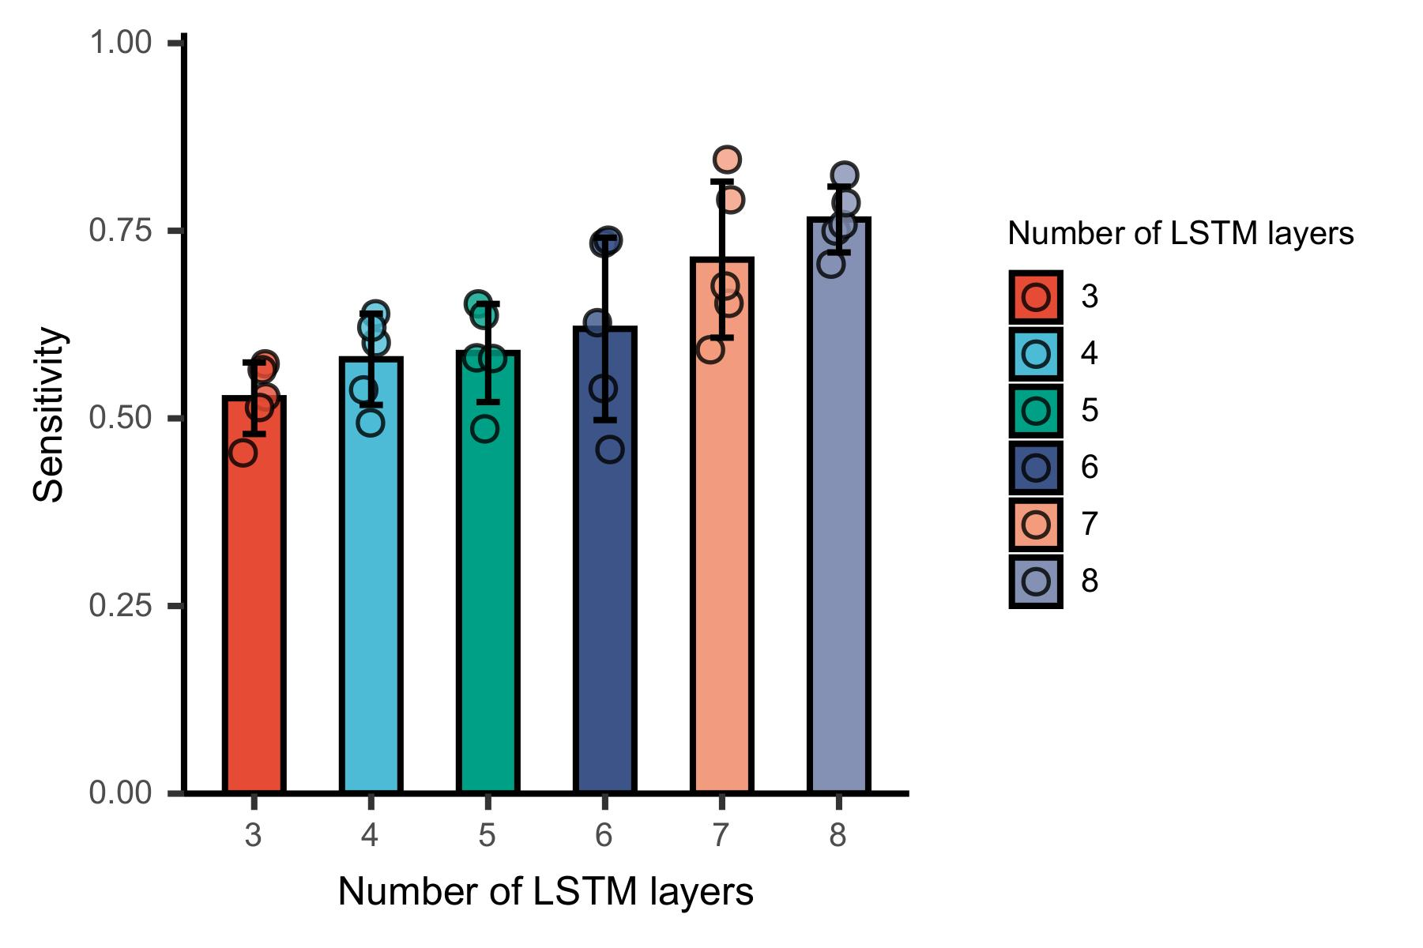
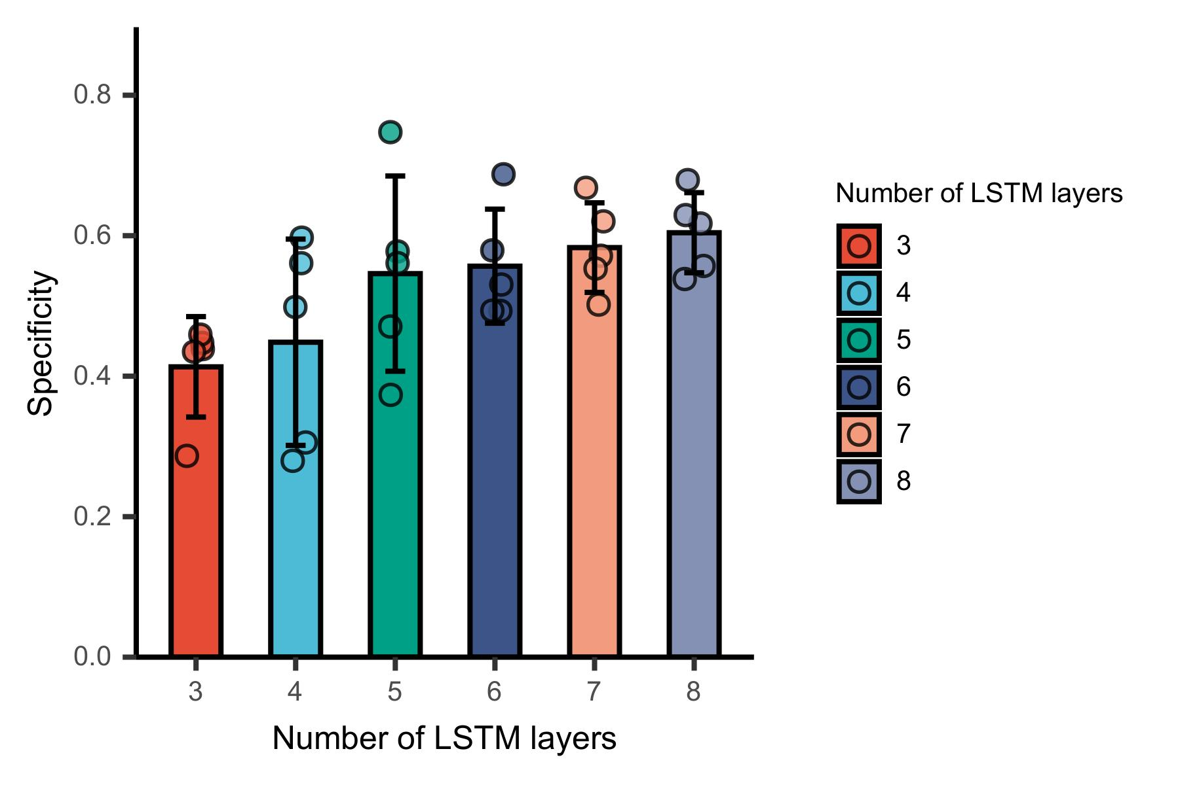
Robust Model Parameter Selection - Part II

Slide 24
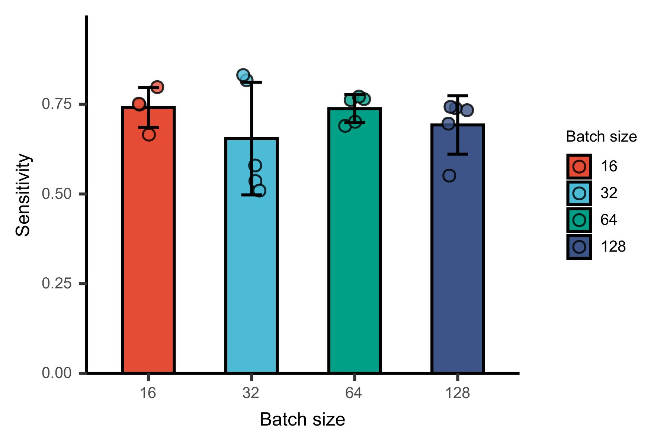
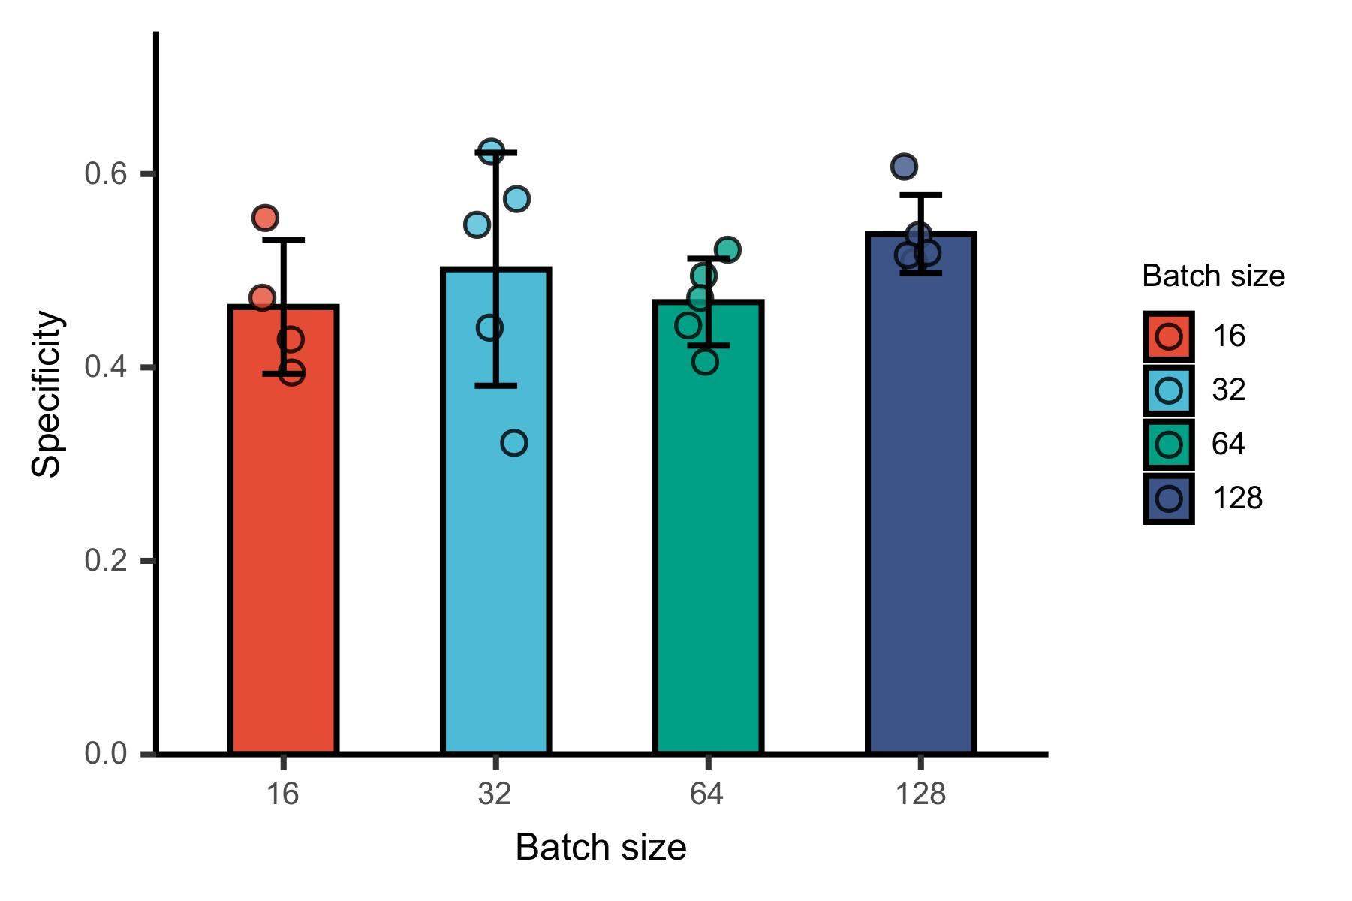
Robust Model Parameter Selection - Part II

Slide 25
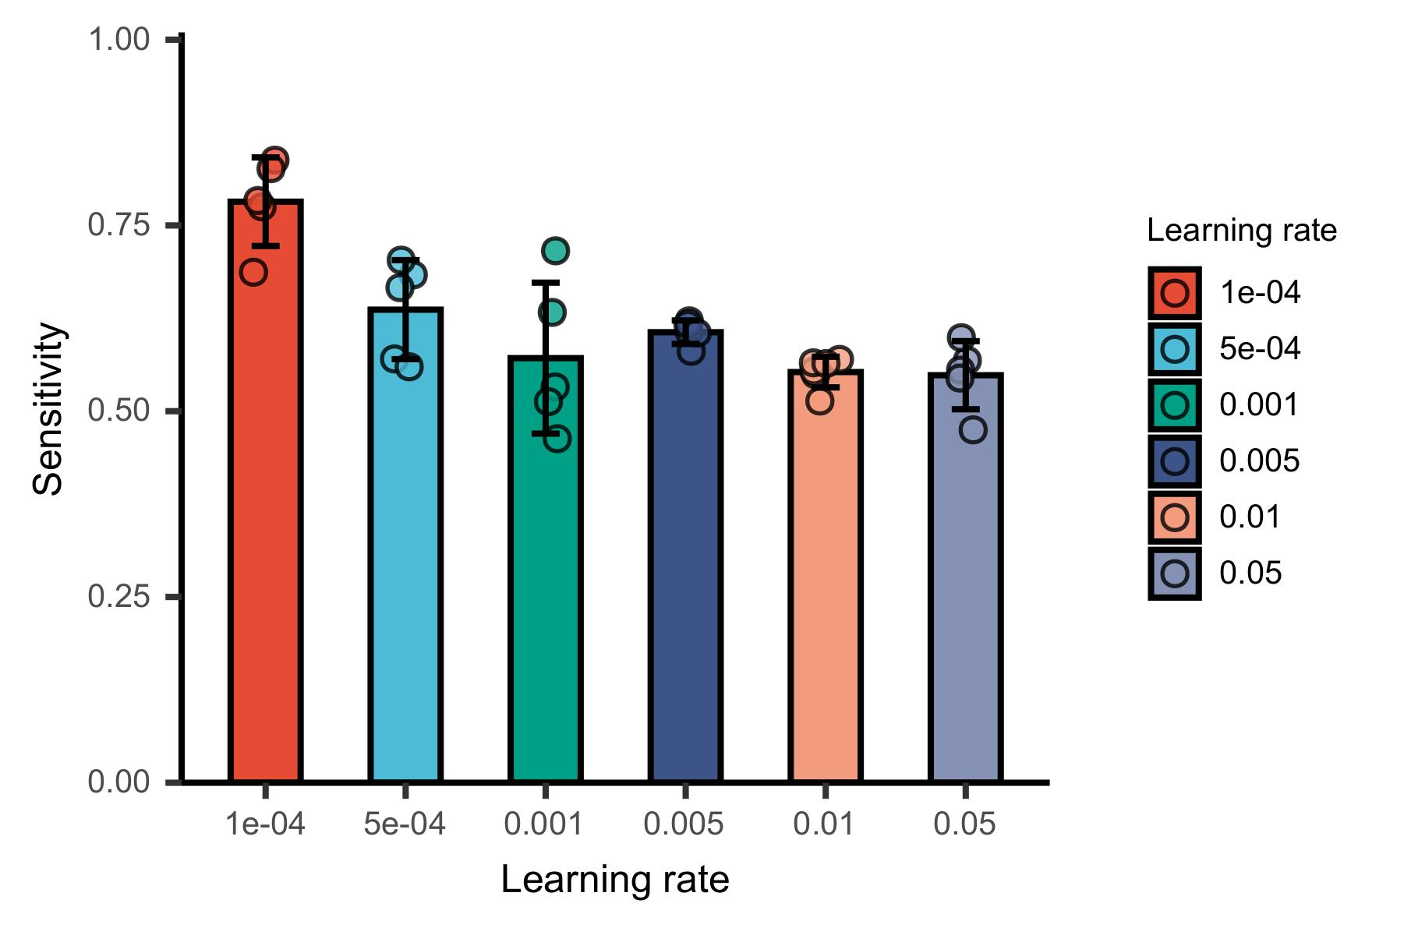
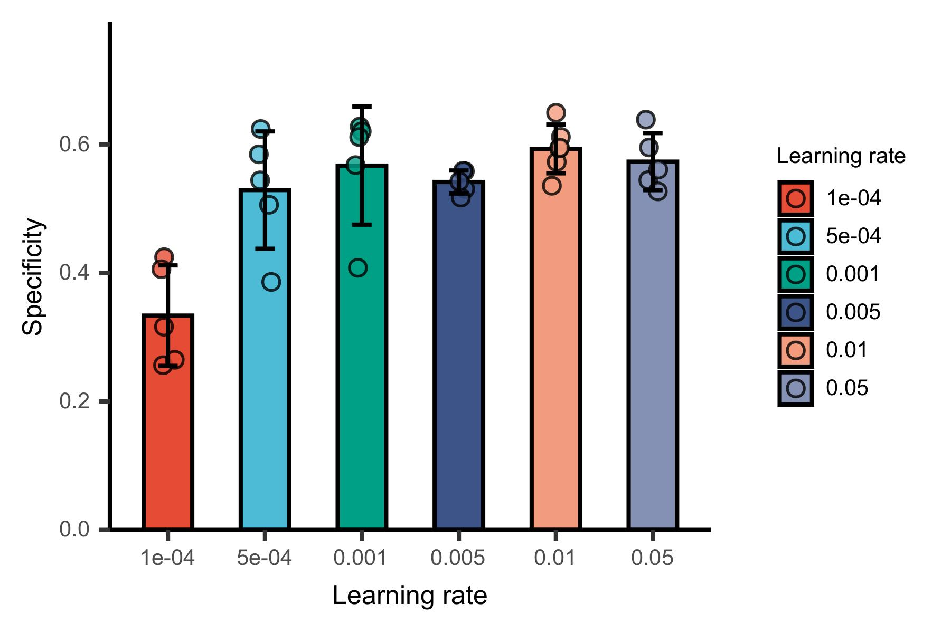
Robust Model Parameter Selection - Part II

Slide 26
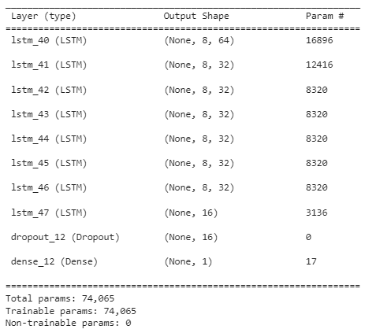
Final model
EPOCHS = 20
BATCH_SIZE = 128
LEARNING_RATE = 5e-4
model.compile(optimizer='adam', loss='binary_crossentropy')
Best epoch is selected based on least loss on validation set

Slide 27
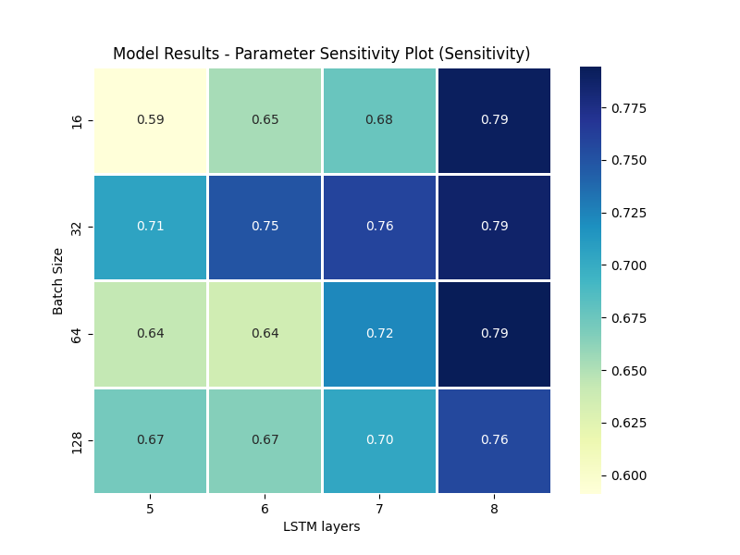
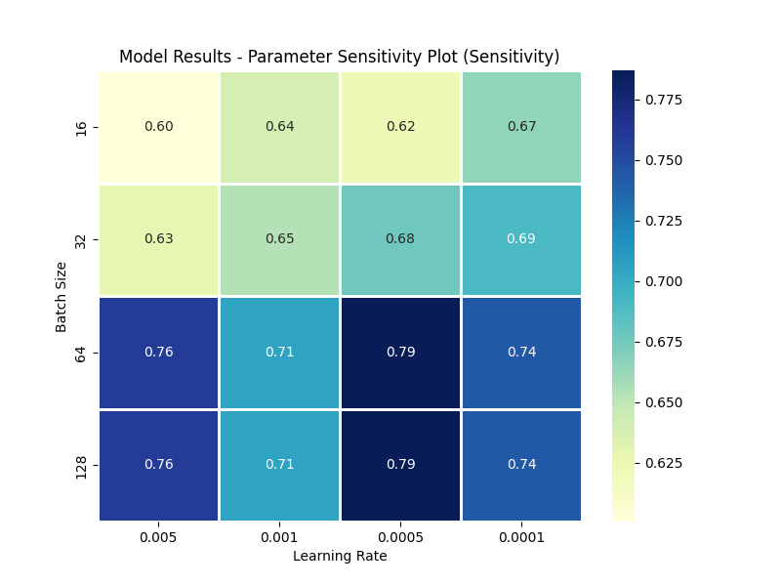
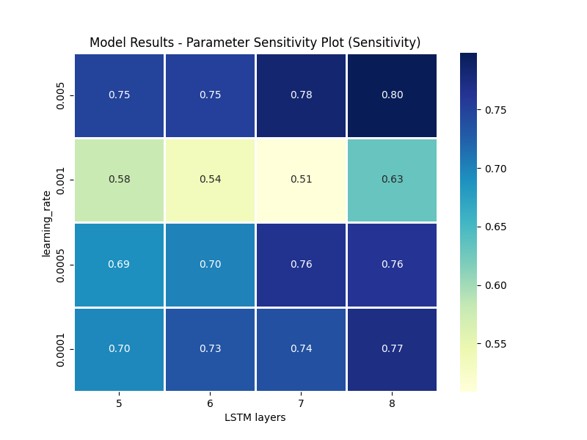
Parameter Sensitivity Plot

Slide 28
Quantitative Data Analysis - Part III
 | Sensitivity | Specificity
Fold 1 | 0.600804 | 0.568869
Fold 2 | 0.535325 | 0.623907
Fold 3 | 0.807007 | 0.405905
Fold 4 | 0.587593 | 0.602265
Fold 5 | 0.599655 | 0.611008
Mean | 0.626077 | 0.562391
STD | 0.10463 | 0.089816
Strip level

Slide 29
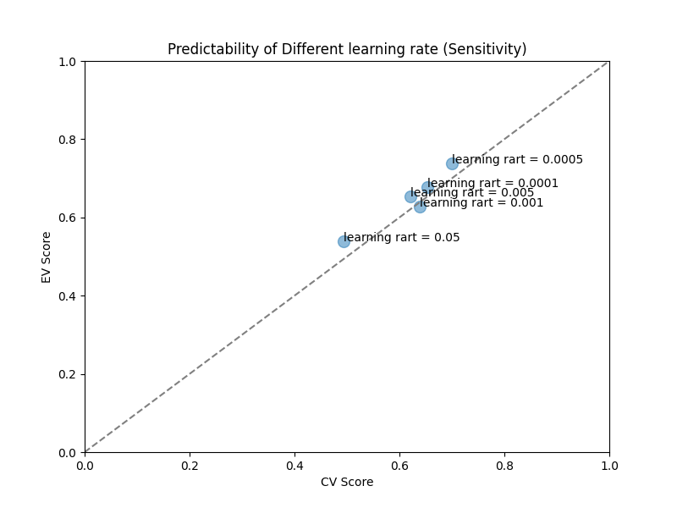
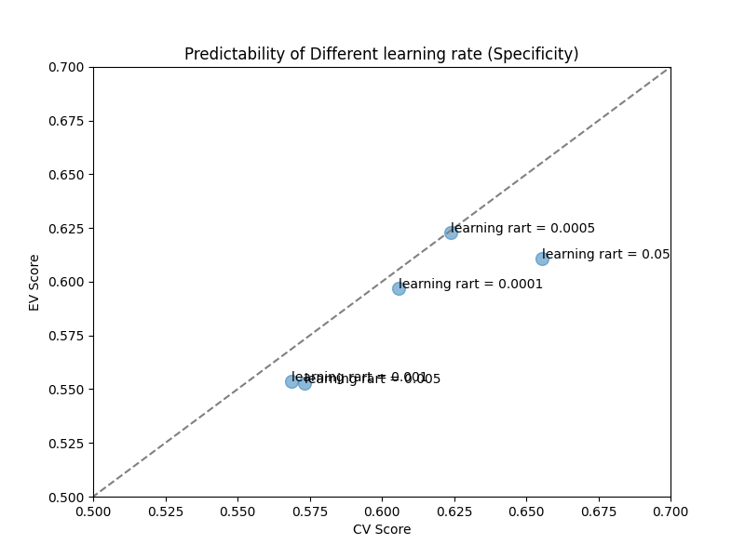
Predictability of Model

Slide 30
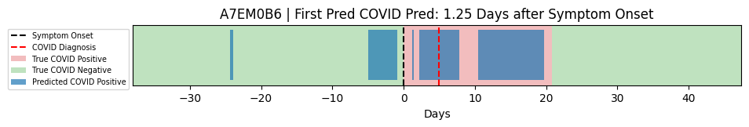
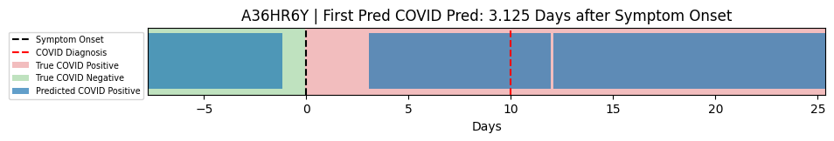
Result Discussion/Interpretation – Covid patients
Average RHR in first day: 65.5
Symptom date | Diagnosis date | Recovery date
2023-12-26 | 2023-12-31 | 2024-01-08
Average RHR in first day: 81.3
Symptom date | Diagnosis date | Recovery date
2023-04-06 | 2023-04-16 | 2023-06-10

Slide 31
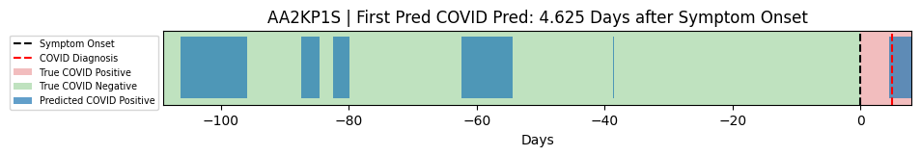
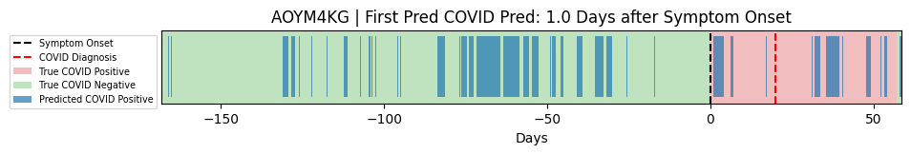
Result Discussion/Interpretation – Covid patients
Average RHR in first day: 76.8
Symptom date | Diagnosis date | Recovery date
2025-01-06 | 2025-01-11 | 2025-01-25 (+14 days) Not reported
Average RHR in first day: 67.1
Symptom date | Diagnosis date | Recovery date
2023-08-29 2022-11-14 2023-07-04 2023-10-24 | 2023-09-18 | 2023-09-19

Slide 32
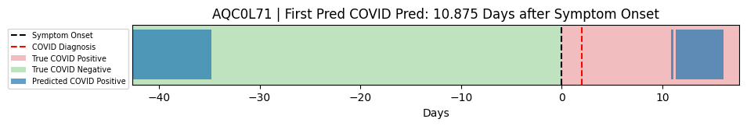
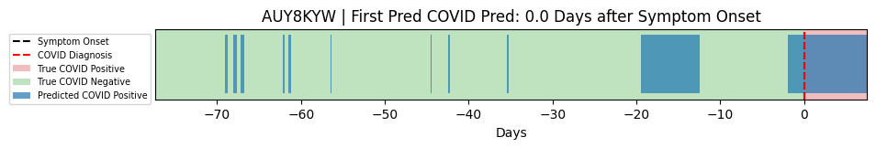
Result Discussion/Interpretation – Covid patients
Symptom date | Diagnosis date | Recovery date
2028-06-17 | 2028-06-19 | 2028-07-03(+14 days) 2028-05-16 (reported) 2028-05-15 (reported)
Average RHR in first day: 73.2
Average RHR in first day: 60.2
Symptom date | Diagnosis date | Recovery date
2024-03-11(-7 days) Real date not reported | 2024-03-18 | 2024-04-02(+14 days) Real date not reported

Slide 33
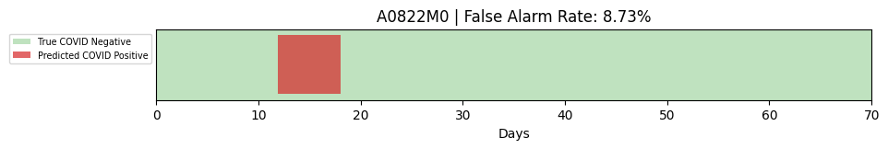
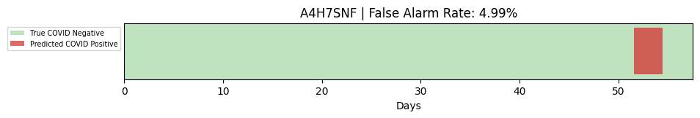
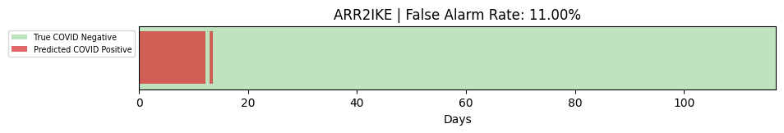
Result Discussion/Interpretation – Healthy patients
Average RHR in first day: 79.1
Average RHR in first day: 63.2
Average RHR in first day: 85.2

Slide 34
Result Discussion/Interpretation - Part III
Pattern Classifier
We found that most of the Covid specific patterns included a high resting heart rate
As support increases, pattern length and quantity decreases
With more patterns, sensitivity increases
With fewer patterns specificity increases
LSTM Strip Classification
Able to achieve sensitivity greater than pattern classifier
Captured the 5 day period of physiological change prior to symptom onset in some patients
The model would greatly benefit from additional data
Lower learning rate and an increased number of LSTM layers lead to higher sensitivity
Batch size and hidden layers had much less of an impact on performance

Slide 35
Comparison vs. Previous works
Bogu, Snyder
Using RHR data with LSTM for anomaly detection (trained on healthy patients)
Sensitivity = 0.36, Precision = 0.91
Our model is much less precise, but more often predicts covid patients as positive
Abir, et.al
Utilizes Variational-AutoEncoder with LSTM, RHR data for anomaly detection
Sensitivity = 0.534, Precision = 0.993
Trained on a much larger dataset
Able to achieve almost 50% pre-symptomatic detection
Much more precise than our model, with similar sensitivity
Mishra, et.al - Dataset source
Anomaly detection using HROS
63% pre-symptomatic detection
Our model works to classify strips of time rather than perform anomaly detection, so the results are difficult to compare directly.
However, our model is much more prone to false positives

Slide 36
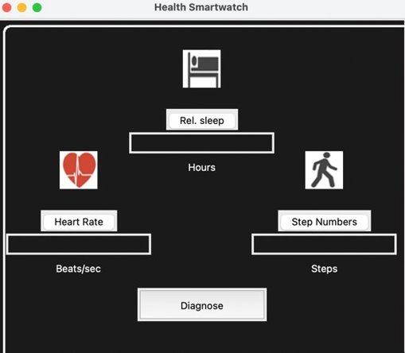
Mock-up System Implementation - Part III
Prediction Window
User (Smartwatch)

Slide 37
Conclusion
Through discretizing patient data into patterns, we were able to find out that covid patient's patterns are more likely to be high heart rate with low step count, indicative of high resting heart rate
Utilizing LSTM for strip classification, we were able to achieve recall = 0.63, specificity = 0.56, which means the model is very likely to make a false positive, but has covid positive results that are comparable to other literature
Limitations
More data is absolutely needed to improve the quality of the model
Currently, heavy dataset augmentation was necessary to achieve adequate results
Discretizing data into pattern bins leads to a large data loss, but made the model more explainable
A high false positive rate compared to literature is not suitable for a real-world implementation

Slide 38
Summary
Covid testing can be very costly in terms of resources and time
Many people wear devices like Fitbits that capture physiological data that can be suggestive of Covid
We transformed the data into sequences of patterns, such that we could find key elements that differentiated between healthy and sick
Resting Heart Rate is a key indicator for Covid used by many previous works and was found as a key factor in our findings as well
We were able to match classification of Covid patients, however with many more false positives than that of previous works
Limitations in data is the biggest issue to tackle, as not enough or poor-quality data will drastically decrease performance

Slide 39
Reference
Goergen, Craig J., et al. "Detection and monitoring of viral infections via wearable devices and biometric data." Annual review of biomedical engineering vol. 24. pp. 1-27. 2022.
Tao, Yudong, et al. "A Survey on Data-Driven COVID-19 and Future Pandemic Management." ACM computing surveys 55.7. pp. 1-36. 2022.
Natarajan, Aravind, et al. "Assessment of physiological signs associated with COVID-19 measured using wearable devices." NPJ digital medicine 3.1 pp. 156. 2020.
Adams, Jamie L., et al. "A real-world study of wearable sensors in Parkinson’s disease." npj Parkinson's Disease 7.1 pp. 106. 2021.
Wang, Zhiyuan, et al. "Mobile Sensing in the COVID-19 Era: A Review." Health Data Science. 2022.
Chatterjee, A., Gerdes, M. W., & Martinez, S. G. Statistical explorations and univariate timeseries analysis on COVID-19 datasets to understand the trend of disease spreading and death. Sensors, 20(11), pp. 3089. 2022
Maghded, Halgurd S., et al. "A novel AI-enabled framework to diagnose coronavirus COVID-19 using smartphone embedded sensors: design study." 2020 IEEE 21st International Conference on Information Reuse and Integration for Data Science (IRI). pp. 180-187. 2020
Grzesiak, Emilia, et al. "Assessment of the feasibility of using noninvasive wearable biometric monitoring sensors to detect influenza and the common cold before symptom onset." JAMA network open 4.9. pp. E2128534-e2128534. 2021.
Radin, Jennifer M., et al. "Harnessing wearable device data to improve state-level real-time surveillance of influenza-like illness in the USA: a population-based study." The Lancet Digital Health 2.2. (2020). e85-e93.
Bogu, Gireesh K., and Michael P. Snyder. "Deep learning-based detection of COVID-19 using wearables data." MedRxiv. 2021.
Liu, Shuo, et al. "Fitbeat: COVID-19 estimation based on wristband heart rate using a contrastive convolutional auto-encoder." Pattern recognition 123. pp. 108403. 2022.
Abir, Farhan F, et al. PCovNet: A presymptomatic COVID-19 detection framework using deep learning model using wearables data. Computers in Biology and Medicine, 147, pp. 105682. 2022.

